Slide 1
Year 11 to 12 bridging tasks
Course – BTEC National in
Children’s Play Learning and Development

Slide 2
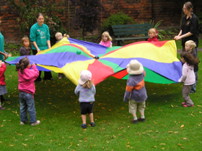
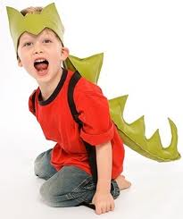
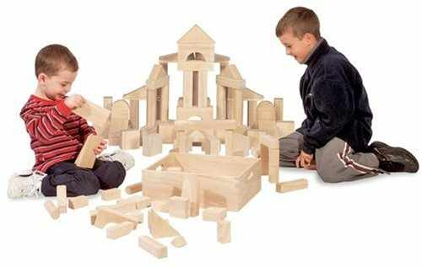
Bridging Task 1 The five types of play are;
Physical
Imaginative / pretend
Sensory
Creative arts and design
Construction/Manipulative

Slide 3
Task 1 - Investigate the 5 different types of play.
Watch the following videos and make notes.
The benefits of play
https://www.bing.com/videos/search?q=benefits+of+play&&view=detail&mid=09997002F5FDCAFD43E209997002F5FDCAFD43E2&&FORM=VRDGAR&ru=%2Fvideos%2Fsearch%3Fq%3Dbenefits%2Bof%2Bplay%26FORM%3DHDRSC3
Benefits of physical play
https://www.bing.com/videos/search?q=what+is+physical+play&&view=detail&mid=496E29018150E5B0DE5C496E29018150E5B0DE5C&&FORM=VRDGAR&ru=%2Fvideos%2Fsearch%3Fq%3Dwhat%2Bis%2Bphysical%2Bplay%26FORM%3DHDRSC3
Creative play
https://www.bing.com/videos/search?q=creative+play&&view=detail&mid=827F6C4E9DFC54C0E6F4827F6C4E9DFC54C0E6F4&&FORM=VRDGAR&ru=%2Fvideos%2Fsearch%3Fq%3Dcreative%2Bplay%26FORM%3DHDRSC3
and
https://www.bing.com/videos/search?q=creative+play&&view=detail&mid=BE71F5B5DE63ECA9258ABE71F5B5DE63ECA9258A&&FORM=VRDGAR&ru=%2Fvideos%2Fsearch%3Fq%3Dcreative%2Bplay%26FORM%3DHDRSC3
What is imaginative play?
https://www.bing.com/videos/search?q=what+is+imaginative+play&&view=detail&mid=70228BC3EB39FB48A18670228BC3EB39FB48A186&&FORM=VRDGAR&ru=%2Fvideos%2Fsearch%3Fq%3Dwhat%2Bis%2Bimaginative%2Bplay%26FORM%3DHDRSC3
Construction play
https://www.bing.com/videos/search?q=what+is+construction+play&&view=detail&mid=CA2E539E35AEC95AA69DCA2E539E35AEC95AA69D&&FORM=VRDGAR&ru=%2Fvideos%2Fsearch%3Fq%3Dwhat%2Bis%2Bconstruction%2Bplay%26FORM%3DHDRSC3
Sensory play
https://www.bing.com/videos/search?q=what+is+sensory+play&ru=%2fvideos%2fsearch%3fq%3dwhat%2bis%2bsensory%2bplay%26FORM%3dHDRSC3&view=detail&mid=8D9DDE336EEA066912798D9DDE336EEA06691279&&FORM=VDRVRV
and
https://www.bing.com/videos/search?q=what+is+sensory+play&ru=%2fvideos%2fsearch%3fq%3dwhat%2bis%2bsensory%2bplay%26FORM%3dHDRSC3&view=detail&mid=709A1FBF938322E8933E709A1FBF938322E8933E&rvsmid=8D9DDE336EEA066912798D9DDE336EEA06691279&FORM=VDRVRV

Slide 4
Task 2
Secret life of 4 year olds and make notes on different activities they take part in and mini case studies of the different children.
https://www.channel4.com/programmes/the-secret-life-of-4-and-5-year-olds/on-demand/61827-001
https://www.channel4.com/programmes/old-peoples-home-for-4-year-olds

Slide 5
Task 3
The development of the child is divided into 5 main areas.
PLIES- Create a picture board for the different milestones at different stages and ages of development for each developmental area.
Physical development
Emotional development
Language development
The child
Social development
Intellectual development

