Slide 1
Task 1: Make flash cards of definitions for the following key words
Biological molecules:
Covalent bonding
Ionic bonding
Hydrogen bonding
Polarised
Monomers
Polymers
Condensation reactions
Cell structure:
Resolution
Magnification
Cell specialisation
Epithelial tissues
Eukaryotic cells
Prokaryotic cells
Mitosis

Slide 2
Transport across cell membranes:
Plasma membrane
Phospholipid
Diffusion
Facilitated diffusion
Osmosis
Active transport
Cell recognition and the immune system:
Pathogen
Immunity
Antigen
Lymphocyte
Antibody
Monoclonal antibody
Herd immunity

Slide 3
Exchange between organisms and their environment:
Surface area to volume ratio
Mass transport
Counter-current flow
Stomata
Transpiration
Xerophytes
Water potential
Structure of the human gas-exchange system:
Trachea
Bronchi
Bronchioles
Alveoli
Inspiration
Expiration
Internal intercostal muscles
External intercostal muscles

Slide 4
Enzymes and digestion:
Enzymes
Amylase
Protease
Lipase
Denature
Mass transport:
Primary structure
Secondary structure
Tertiary structure
Haemoglobin

Slide 5
Circulatory systems:
Metabolism
Atrium
Ventricle
Aorta
Vena cava
Pulmonary artery
Pulmonary vein
Coronary artery
Arteries
Veins
Capillaries
Transport of water:
Primary structure
Secondary structure
Tertiary structure
Haemoglobin

Slide 6
DNA, genes and protein synthesis:
Gene
Genetic code
Chromosome
Chromatid
Homologous
Diploid
Haploid
Allele
Meiosis
Genome
Genetic diversity and adaptation:
Mutation
Gametes
Gene pool
Natural selection
Anatomical
Physiological
Behavioural

Slide 7
Biodiversity:
Classification
Taxonomy
Domain
Community
Species richness
Habitat
Biomass
Ecosystems
Random sampling

Slide 8
Task 2: Annotate the diagrams
The following diagrams on the next two slides are of an animal cell and a plant cell
These are in much more detail than Y11 and you need to carry out some research in order to fully label them
See if you can add some annotations to describe the function of each organelle you have labelled

Slide 9
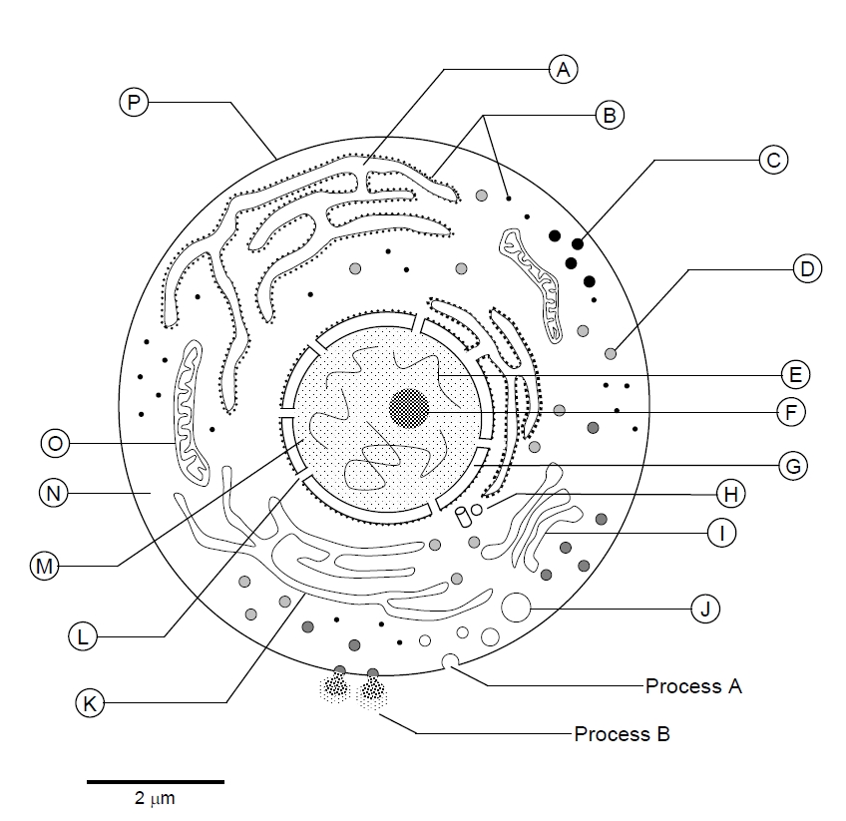

Slide 11
Task 3: Revisit Y11 content
Use your notes/revision guide from Y11 to write up neat notes of the digestion system, food tests and enzymes
Create a summary poster for this topic

Slide 12
Task 4: Research Task
Choose one of the following topics:
Viruses
Gas exchange in insects
Transport of water in the xylem
Genetic code
Biodiversity
Research your chosen topic and carry out further reading around this topic (reference where you got your information from)
Choose how to present your work, e.g. powerpoint, word document, summary poster

